Slide 1

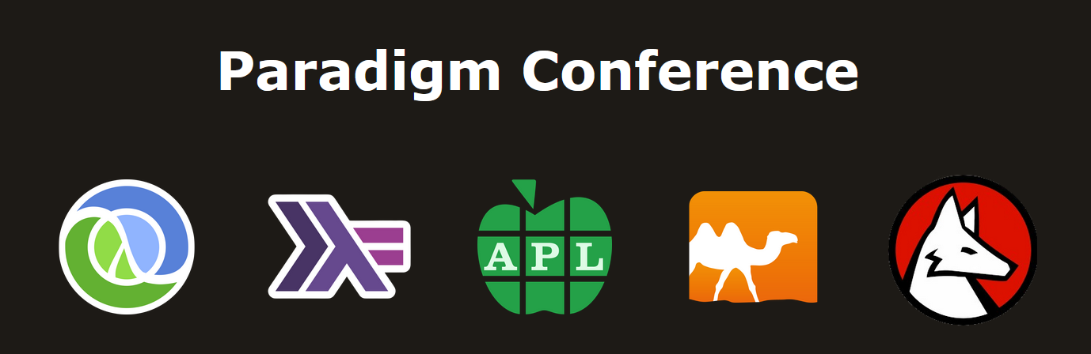
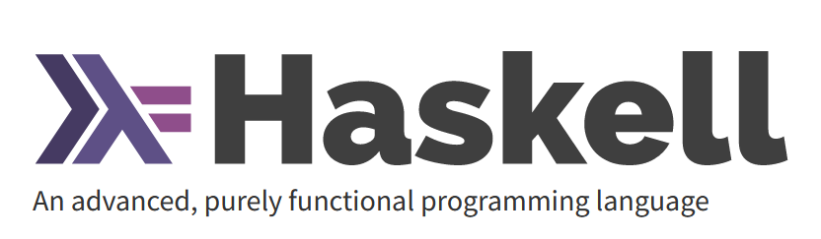
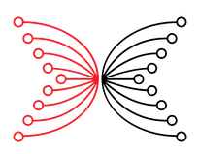
Introducing
Luka Kurnjek IOG

Slide 2

About IOG and myself
Input Output Global - iohk.io
~ 500 people, remote, 57 countries.
Blockchain based open-source software (cardano.org).
Mostly Haskell for development and testing.
Research with universities (159 papers):
Cryptography, Distributed Systems, Programming Languages, Economics ...
I’m in Education team: free tutorials and classes (online and on-site)
Currently we’re working on a Haskell bootcamp

Slide 3
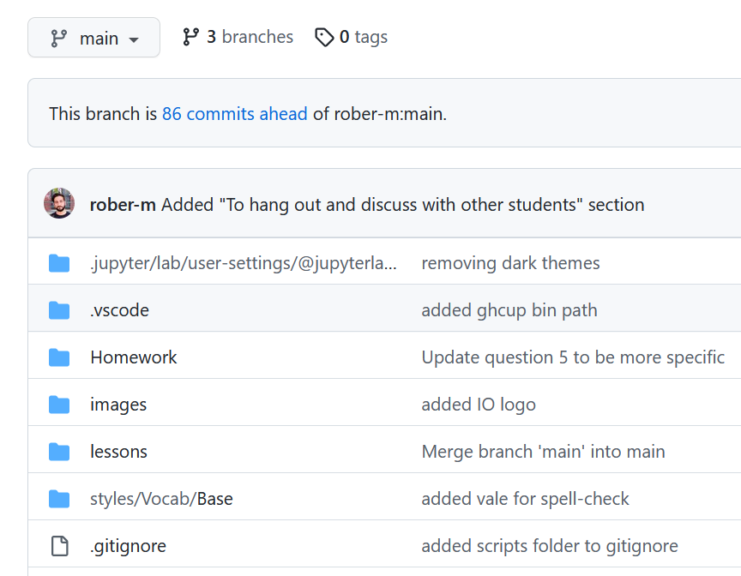
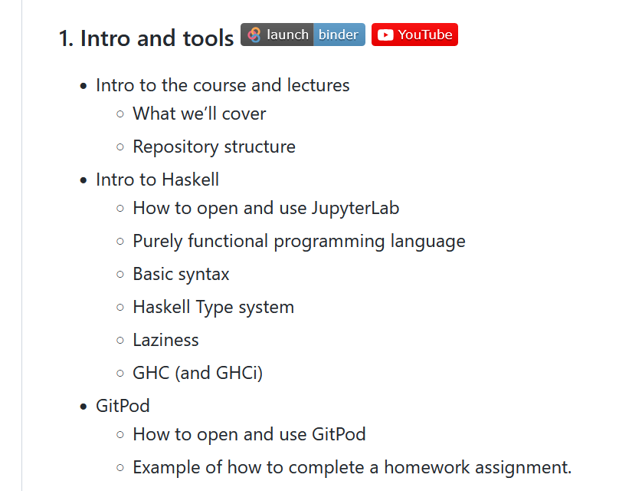
Haskell bootcamp
Branches: solutions dev
Lesson files
Interactive lesson
Lectures

Slide 4
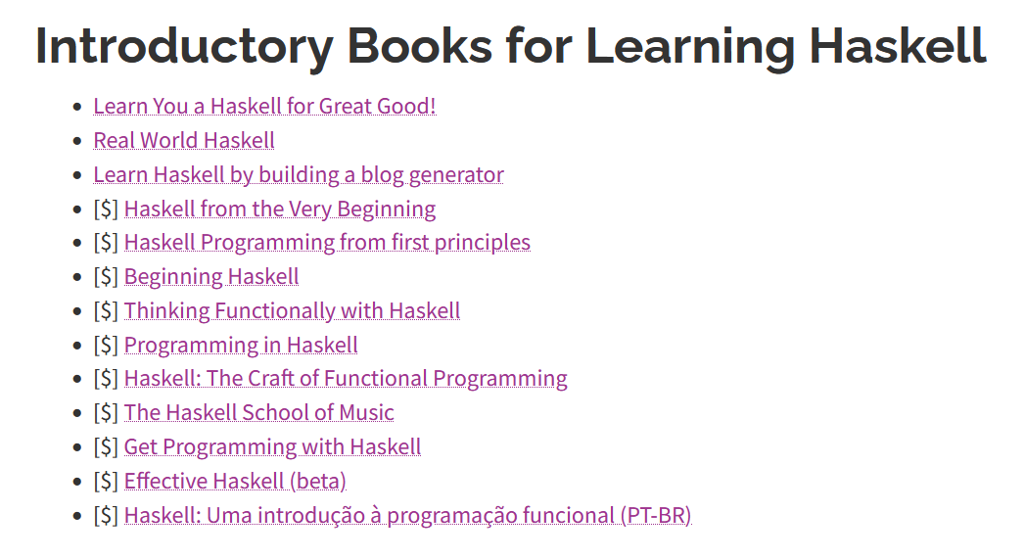
Haskell resources
www.haskell.org/documentation/

Slide 5
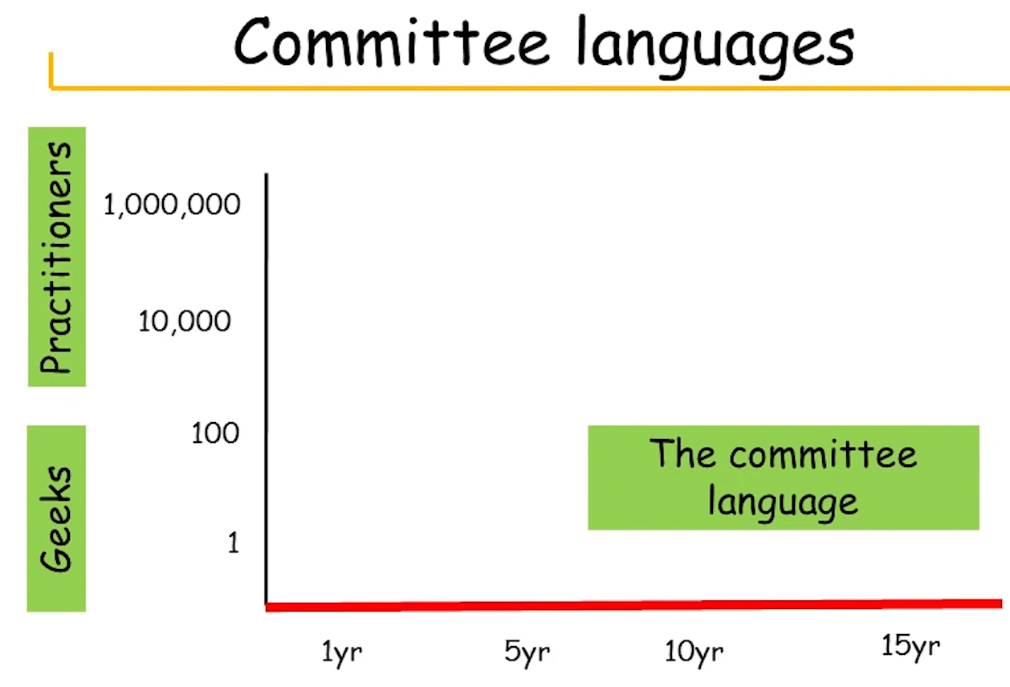
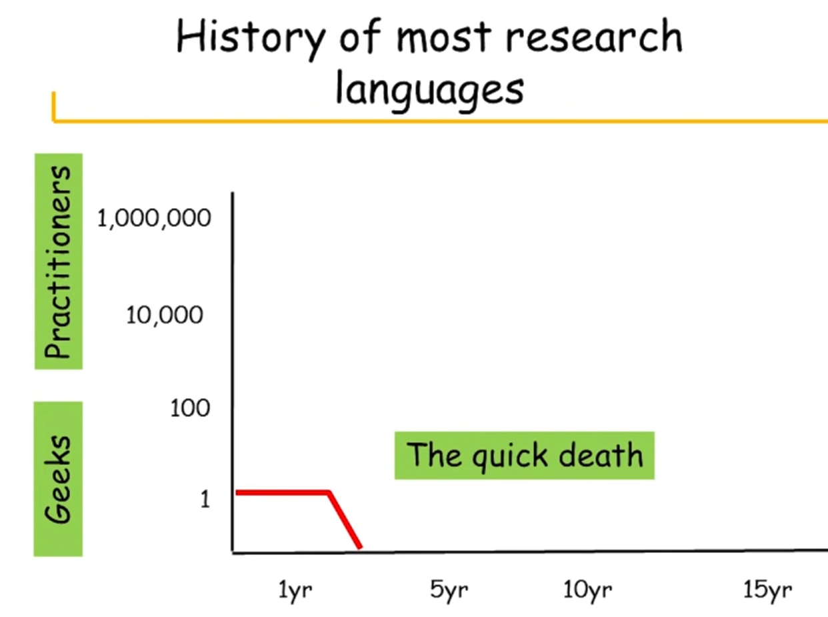
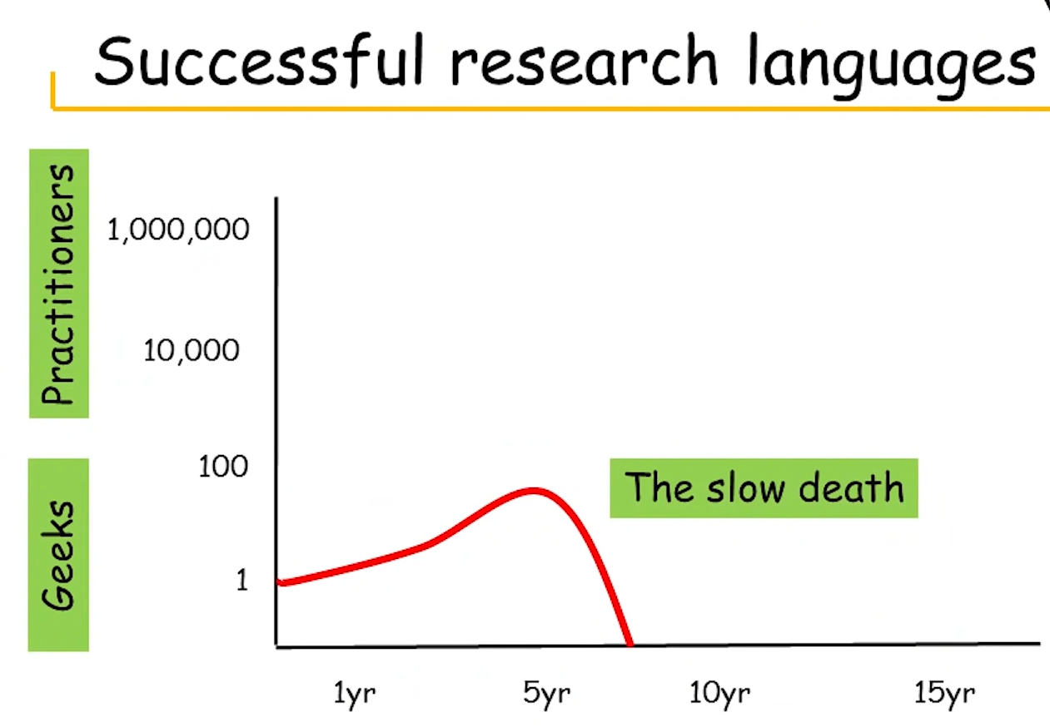
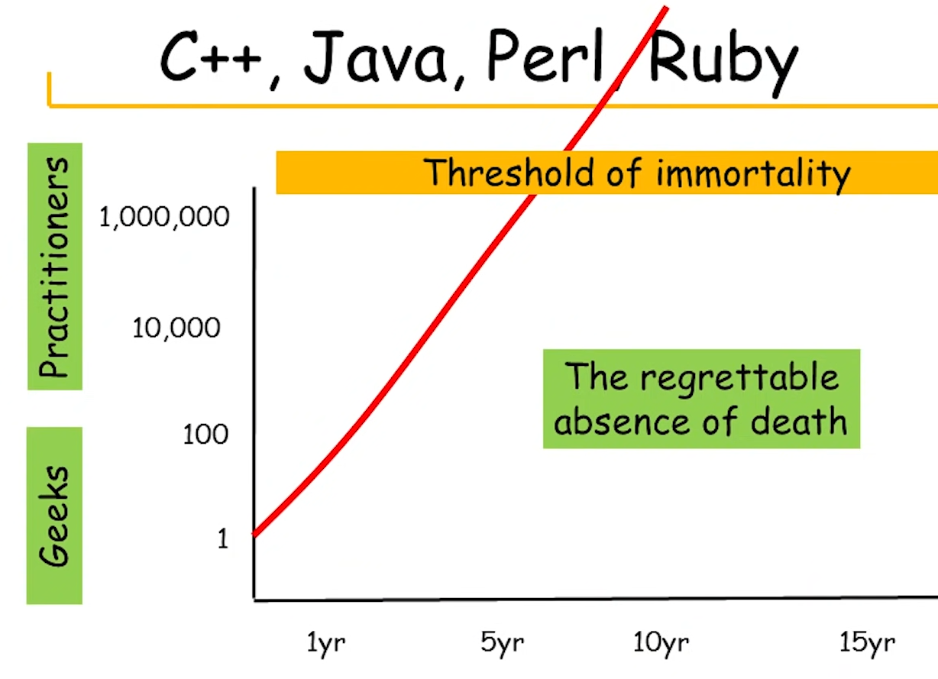
About Haskell
First appeared 1990
Designed by around 30 people
GHC – Glasgow Haskell Compiler
28th most popular (google searches 2021)
Simon Peyton-Jones: the Haskell journey

Slide 6
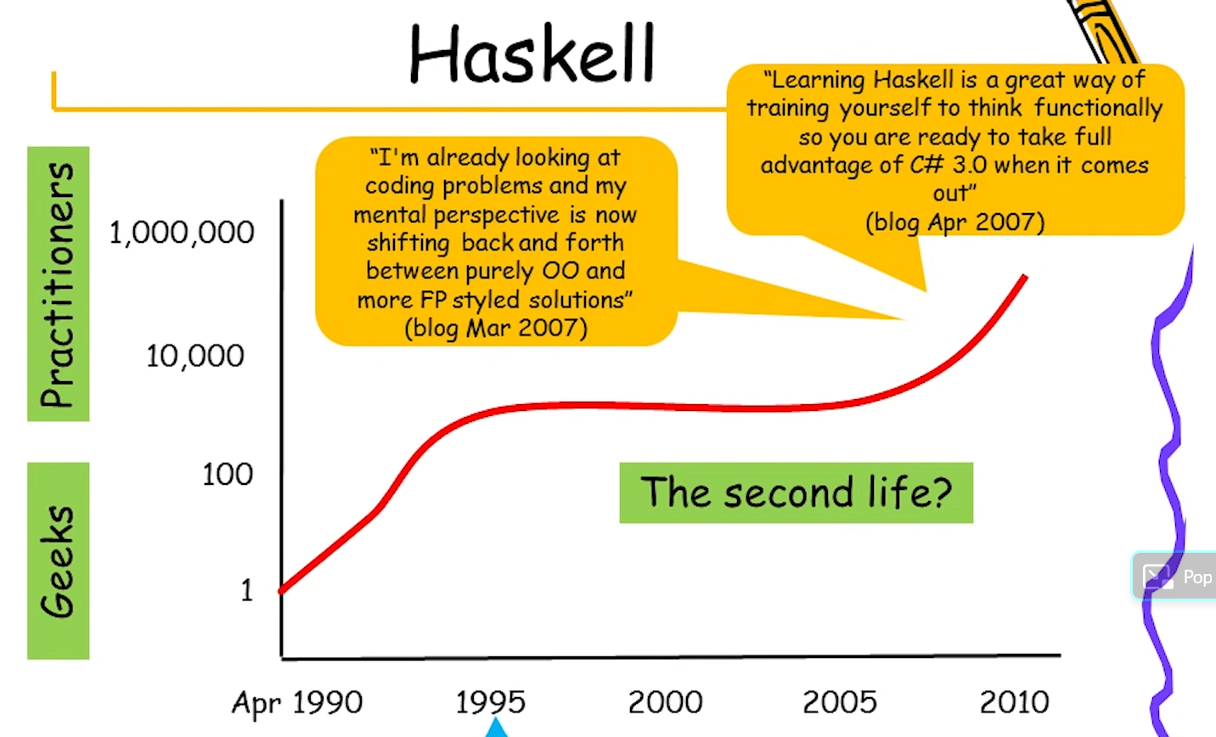
Haskell’s journey

Slide 7
What kind of PL is Haskell
1. Statically typed with type inference
charA :: Char
charA = 'A'
int123 :: Int
int123 = 123
string = " number " :: String
-- together :: String
together = [char] ++ string
++ show int
-- together == "A number 123"

Slide 8
1. Statically typed with type inference
import Data.Char (isDigit)
onlyLetters :: Char -> Char -> Bool
onlyLetters char1 char2 = isDigit1 && isDigit2
where isDigit1 = not (isDigit char1)
isDigit2 = not $ isDigit char2
onlyLetters 'a' 'b' -- returns True
onlyLetters 'a' "1" -- returns an error

Slide 9
1. Statically typed with type inference
charA :: Char
charA = 'A' int123 :: Int
int123 = 123
string = " number " :: String
together = [char] ++ string
++ show int
import Data.Char (isDigit)
onlyLetters :: Char -> Char -> Bool
onlyLetters char1 char2 = isDigit1 && isDigit2
where isDigit1 = not (isDigit char1)
isDigit2 = not $ isDigit char2
onlyLetters 'a' 'b' -- returns True
onlyLetters 'a' "1" -- returns an error
Conventions:
Lower case: functions and variables
Upper case: types and modules
Type annotation :: (not mandatory)
Mandatory indentation (sub-blocks)
No brackets for function variables
Functions are first class citizens
Comments: -- some text
Block comments: {- some text -}

Slide 10
2. Purely functional
Functional style
Preferably using pure functions and minimizing side effects and mutable data.
Mutable data: variables and functions can change
Side effects: data that comes from input, web, randomness …
-> code gets unpredictable
real world effects: printing, API calls …
Pure functions: output depends only on the input
-> no side effects
-> no usage of global mutable variables
-> no impure function calls
Purely functional style
Impure functions only allowed with a type signature that indicates side effects.
All variables and functions (pure and impure) are immutable by default.

Slide 11
Practical implications
Pure functions:
take in one or more argument
always return a value
are predictable
checkLocalhost :: String -> String
checkLocalhost ip =
if ip == "127.0.0.1"
then "It's localhost!"
else "No, it's not localhost."
No for-loops. Alternative: Haskell helper functions that work on lists:
Lists (data structures): all elements have same type
Constructed with cons operator “:”
[1,2,3,4] == 1:2:3:4:[]
"Hi!" == 'H':'i':'!':[]

Slide 12
Practical implications
Haskell helper functions that work on lists.
map :: (a -> b) -> [a] -> [b]
addNToList :: Int -> [Int] -> [Int]
addNToList n list = map (+n) list
addNToList 2 [1..3] -- returns [3,4,5]
filter :: (a -> Bool) -> [a] -> [a]
largerThan5 :: [Int] -> [Int]
largerThan5 myList = filter (>5) myList
largerThan5 [1..8] -- returns [6,7,8]
foldl :: (b -> a -> b) -> b -> [a] -> b
foldl (-) 5 [1..4] -- returns -5
foldl 1. step: 5 - 1 = 4
2. step: 4 - 2 = 2
3. step: 2 - 3 = -1
4. step: -1 - 4 = -5
foldr :: (a -> b -> b) -> b -> [a] -> b
foldr (-) 5 [1..4] -- returns 3
foldr 1. step: 4 - 5 = -1
2. step: 3 - (-1) = 4
3. step: 2 - 4 = -2
4. step: 1 - (-2) = 3

Slide 13
Practical implications
Another for-loop alternative: recursion - functions calling them self
myProduct' :: [Int] -> Int
myProduct' xs = if xs == [] then 0
else multiply xs
where multiply xs = if xs == [] then 1
else head xs *
multiply (tail xs)
myProduct :: [Int] -> Int
myProduct [] = 0
myProduct [x] = x
myProduct (x:xs) = x * myProduct xs
Pattern matching helps with recursion:
myProduct' [1,2,3] -- returns 6
myHead :: [Int] -> Int
myHead (x:xs) = x
myHead [1,2,3] -- returns 1
Build-in Haskell functions:
myTail :: [Int] -> [Int]
myTail [] = []
myTail (x:xs) = xs
myTail [1,2,3] -- returns [2,3]
head [1,2,3] == 1
tail [1,2,3] == [2,3]

Slide 14
3. Lazy
In Haskell functions and variables are lazy:
They are only evaluated when they are needed.
NOTE: Some built in functions are strict (opposite to lazy).
{-# LANGUAGE BangPatterns #-}
mult :: Int -> Int -> Int
mult x y = x * y
main2 :: IO ()
main2 = do
let !var1 = mult (1 * 2) (2 * 2)
!var2 = mult (1 * 1) (1 * 3)
print ("var1: " ++ show var1)
-- returns 8
mult :: Int -> Int -> Int
mult x y = x * y
main1 :: IO ()
main1 = do
let var1 = mult (1 * 2) (2 * 2)
var2 = mult (1 * 1) (1 * 3)
print ("var1: " ++ show var1)
-- returns 8

Slide 15
3. Lazy
Haskell builds so-called thunks (promises)
Benefit: code not needed is not computed
Downside: thunk space allocation
cleaning thunk afterward
10 thunks are created:
1+3: add (1*1) (1*3)
1+2: 1 * 1
1+2: 1 * 3
1+ is for the thunk to be identified as a thunk
mult :: Int -> Int -> Int
mult x y = x * y
main1 :: IO ()
main1 = do
let var1 = mult (1 * 2) (2 * 2)
var2 = mult (1 * 1) (1 * 3)
print ("var1: " ++ show var1)
-- returns 8

Slide 16
Benefits of Haskell
1. Much less runtime bugs
Compiler catches a lot of compile-time errors:
Null pointers are impossible
"What are the legal values of this parameter?"
is usually trivial to answer
Wrong argument order is likely to cause type errors
Wrong argument count will cause type errors
From reddit discussion.

Slide 17
1. Much less runtime bugs
Data types for handling errors and missing values
data Bool = True | False
data Maybe a = Nothing | Just a
myInit :: [a] -> Maybe a
myInit [] = Nothing
myInit (x:xs) = Just x
myInit [1,2,3] :: Maybe Int
-- Just 1
myInit [] :: Maybe Int
-- Nothing
data Either a b = Left a | Right b
myInit’ :: [a] -> Either String [a]
myInit’ [] = Left "Error: The input
list is empty"
myInit’ (x:xs) = Right x
myInit’ [1,2,3] :: Either String Int
-- Right 1
myInit’ [] :: Either String Int
-- Left “Error: The input list is empty"
Can you spot the compile error in myInit’?

Slide 18
1. Much less runtime bugs
No bugs because of immutable data.
JavaScript code
function addNumber(items) {
for (var i = 0; i < items.length; i++) {
items[i] = function () { return i; };
}
return items;
}
const empty = [{}, {}, {}];
const data = addNumber(empty);
console.log(data[0]()) // returns 2
console.log(data[1]()) // returns 2
console.log(data[2]()) // returns 2
var keyword: global scope!
“i” exists outside the for loop.
“i” gets final value at the end of the loop.
data[1]()
data[2]() function () {return 2;}
data[3]()

Slide 19
data Player = Player {lives :: Int,
attack :: Int} deriving Show
player1 :: Player
player1 = Player {lives = 15,
attack = 10}
player2 :: Player
player2 = Player {lives = 30,
attack = 5}
score :: Player -> Player -> Player
score attacker defender =
if lives attacker > 0 then
defender {lives = (lives defender) - (attack attacker)}
else defender
player1FirstRound = score player2 player1
player2FirstRound = score player1FirstRound player2
player1SecondRound = score player2FirstRound player1FirstRound
player2SecondRound = score player1SecondRound player2FirstRound
player1ThirdRound = score player2SecondRound player1SecondRound
player2ThirdRound = score player1ThirdRound player2SecondRound
State control
-- Result
print player1ThirdRound
Player {lives = 0, attack = 10}
print player2ThirdRound
Player {lives = 10, attack = 5}

Slide 20
data Player = Player {lives :: Int,
attack :: Int} deriving Show
player1 :: Player
player1 = Player {lives = 15,
attack = 10}
player2 :: Player
player2 = Player {lives = 30,
attack = 5}
score :: Player -> Player -> Player
score attacker defender =
if lives attacker > 0 then
defender {lives = (lives defender) - (attack attacker)}
else defender
player1FirstRound = score player2 player1
player2FirstRound = score player1FirstRound player2
player1SecondRound = score player2FirstRound player1FirstRound
player2SecondRound = score player1SecondRound player2FirstRound
player1ThirdRound = score player2SecondRound player1SecondRound
player2ThirdRound = score player1ThirdRound player2SecondRound
State control
Control state at any time:
The last 6 statements can be re-arranged in any order and we will get the same result.
Very practical in concurrent programming.

Slide 21
2. Speed
Quicksort implementation in Haskell and the compile time in GHC and C++.
quicksort :: [Int] -> [Int]
quicksort [] = []
quicksort (p:xs) = (quicksort lesser) ++
[p] ++ (quicksort greater)
where
lesser = filter (< p) xs
greater = filter (>= p) xs
main = do
let list = [9, 3, 4, 2, 1, 8]
print $ quicksort list
$ time (ghc test.hs)
real 0.849s
$ time (runhaskell qs.hs)
[1,2,3,4,8,9]
real 0.309s
$ time (g++ qs.cpp)
1 2 3 4 8 9
real 0.335s
C++ code of quicksort algorithm (much longer) :
https://www.geeksforgeeks.org/cpp-program-for-quicksort/

Slide 22
3. Elegant with features
Elegant: shorter and clearer code
Python code
def primes(n):
primeNums = []
for x in range(2,n+1):
isPrime = True
for p in primeNums:
if x % p == 0: isPrime = False
if isPrime == True: primeNums.append(x)
return primeNums

Slide 23
3. Elegant with features
Elegant: shorter and clearer code
Haskell code
primes :: Int -> [Int]
primes n = filterPrime [2..n]
where filterPrime [] = []
filterPrime (p:xs) =
p : filterPrime [x | x <- xs, x `mod` p /= 0]

Slide 24
3. Elegant with features
Features
Partial application – but be aware of bugs
Lambda function
mult :: Int -> Int -> Int
mult x y = x * y
multWith5 :: Int -> Int
multWith5 = mult 5
print (multWith5 2)
print (mult 5) 2
-- returns 10
mult = \x y z -> x * y * z
main :: IO ()
main = do
let var1 = 2
var2 = 5
multWith5 = mult var1
print $ multWith5 var2
-- returns error

Slide 25
3. Elegant with features
Features
Pattern matching
Order matters
specialBirthday :: Int -> [Char]
specialBirthday 1 = "First birthday!"
specialBirthday 18 = "You're an adult!"
specialBirthday 64 = "In a fair country
you can retire."
specialBirthday age = "Nothing special"
specialBirthday :: Int -> [Char]
specialBirthday age = "Nothing special"
specialBirthday 1 = "First birthday!"
specialBirthday 18 = "You're an adult!"
specialBirthday 64 = "In a fair country
you can retire."
Returns “Nothing special” for every value.

Slide 26
3. Elegant with features
Features
Sum types and parameterized types
Sum types:
combined with logical OR
Product types:
combined with logical AND
data Bool = True | False
data Fruit = Apple | Kiwi | Mango
data Maybe a = Nothing | Just a
data Either a b = Left a | Right b
data Fruit' a = Apple a | Kiwi a | Mango a
fruitPrices :: [Fruit' Int]
fruitPrices = [Apple 2, Kiwi 3]
data FruitPair = Pair Fruit Fruit
pair1 :: FruitPair
pair1 = Pair Apple Kiwi

Slide 27
3. Elegant with features
Features: Record syntax
data BookData = BookData Int Double String
| Empty String
data BookData' = BookData' {yearPublished :: Int,
price :: Double,
author :: String}
| Empty' String
data StoreItem = Food (Fruit' Int) | Book BookData’
item1, item2, item3 :: StoreItem
item1 = Food (Apple 1)
item2 = Book BookData' { yearPublished = 1997,
price = 7.99,
author = "J. K. Rowling"
}
item3 = Book (Empty' "No data available")

Slide 28
3. Elegant with features
Features: Type classes
ghci> :i Int
instance Num Int
instance Show Int
instance Bounded Int
... and some more
ghci> :i Num
class Num a where
(+) :: a -> a -> a
(-) :: a -> a -> a
(*) :: a -> a -> a
negate :: a -> a
abs :: a -> a
signum :: a -> a
fromInteger :: Integer -> a
ghci> :i Show
class Show a where
showsPrec :: Int -> a -> ShowS
show :: a -> String
showList :: [a] -> ShowS
ghci> :i Bounded
class Bounded a where
minBound :: a
maxBound :: a
var = 1 :: Int
var + 1 == 2
show var == "1"
maxBound :: Int
9223372036854775807

Slide 29
3. Elegant with features
Features: Type classe
add :: Num a => a -> a -> a
add x y = x + y
data Number = Zero | One | Two
deriving (Show, Enum)
var1 :: Number
var1 = One
var2 :: Number
var2 = Two
fromEnum var1 -- returns 1
fromEnum var2 -- returns 2
toEnum 0 -- returns Zero
class Num Number where
(+) n1 n2 = toEnum (((fromEnum n1)
+ (fromEnum n2))
`rem` 3) :: Number
...
add var1 var1 -- returns Two
add var1 var2 -- returns Zero

Slide 30
3. Elegant with features
Features: Monad type class
:i Monad
class Applicative m => Monad m where
(>>=) :: m a -> (a -> m b) -> m b
(>>) :: m a -> m b -> m b
return :: a -> m a
string = return "Haskell" :: Maybe String
-- string == Just "Haskell"
actions :: IO ()
actions = print "Learning" >>
print "Haskell"
bindExample :: Maybe Int
bindExample = do
let a = return 1 :: Maybe Int
-- a == Just 1
func :: Int -> Maybe Int
func x = return (x + 1)
(a >>= func)
-- Just 2

Slide 31
3. Elegant with features
Features: Monad type class
ioExample :: IO ()
ioExample = do
print "Input number:"
string <- getLine
let n = read string
add1 x = x + 1
print (add1 n)
ioExample' :: IO ()
ioExample' =
print "Input number:" >>
getLine >>=
(\string ->
return ((\n ->
(\add1 ->
(add1 n)
) (\x -> x + 1)
) (read string)
)
) >>=
print
Ghci> ioExample
"Input number:"
2
3

Slide 32
4. Property testing
QuickCheck library introduce property testing.
Generates input data for property tests.
import Data.List (sort)
import Test.QuickCheck
quicksort :: [Int] -> [Int]
prop_perserveLength list = length list == length (quicksort list)
prop_actuallySorted list = quicksort list == quicksort (quicksort list)
prop_actuallySorted' list = quicksort list == sort list
main :: IO ()
main = do
quickCheckWith stdArgs { maxSuccess = 500} prop_perserveLength
quickCheckWith stdArgs { maxSuccess = 800} prop_actuallySorted
quickCheckWith stdArgs { maxSuccess = 1000} prop_actuallySorted'
OK, passed 1000 tests.
Failed! Falsifiable (after 11 tests and 2 shrinks):
-- example of list that failed

Slide 33
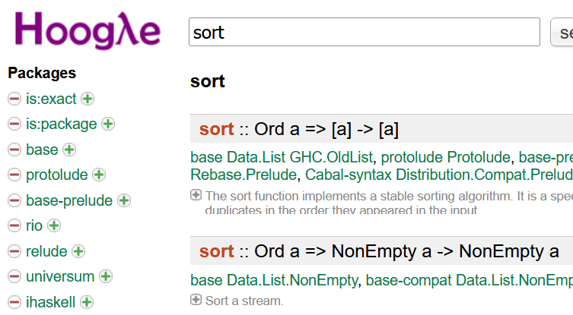
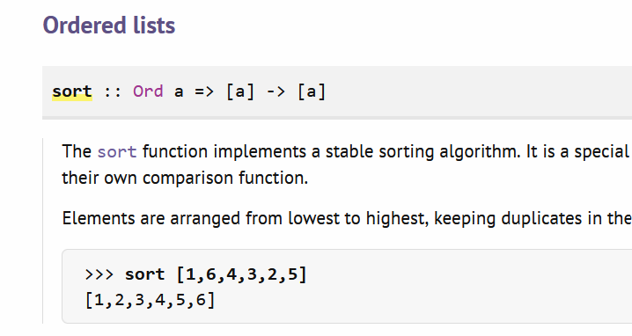
5. Hoogle and Hackage
hoogle.haskell.org:
Haskell API search engine
allows to search Haskell libraries
function name or type signature
redirects to Hackage
hackage.haskell.org:
central Haskell repository
15.586 packages (bundles of functions)
hierarchical structure
description of functions

Slide 34



IOG software
Cardanos native smart
contract language
DSL language for writing
and executing
financial contracts
Self-sovereign identity (SSI) platform for verifiable data and digital identity

Slide 35
Plutus smart contracts
data VestingDatum = VestingDatum
{ beneficiary :: PaymentPubKeyHash
, deadline :: POSIXTime
} deriving Show
PlutusTx.unstableMakeIsData ''VestingDatum
{-# INLINABLE mkValidator #-}
mkValidator :: VestingDatum -> () -> ScriptContext -> Bool
mkValidator dat () ctx = traceIfFalse "beneficiary's signature missing" signedByBeneficiary &&
traceIfFalse "deadline not reached" deadlineReached
where
info :: TxInfo
info = scriptContextTxInfo ctx
signedByBeneficiary :: Bool
signedByBeneficiary = txSignedBy info $ unPaymentPubKeyHash $ beneficiary dat
deadlineReached :: Bool
deadlineReached = contains (from $ deadline dat) $ txInfoValidRange info

Slide 36
Why use Haskell
IOG Aim: Provide access to financial services for 3 billion people that have none.
Path: Provide them digital identity so they can apply for micro-credits.
Technology: Blockchain based money and smart contracts for providing funding.
Charles Hoskinson If you are building something for everyone
IOG CEO and you are building it to last, build it well.
Haskell can give you high assurance code. Bugs are still possible but are fewer.
Most famous smart contract language is Solidity developed by Ethereum.
In July 2016 the fundraising project The DAO build on Ethereum raised $150 million.
Due to several bugs the contract was hacked and around $50 million was drained.
The project got canceled and an Etherum hardfork happened that produced Ethereum classic.

Slide 37
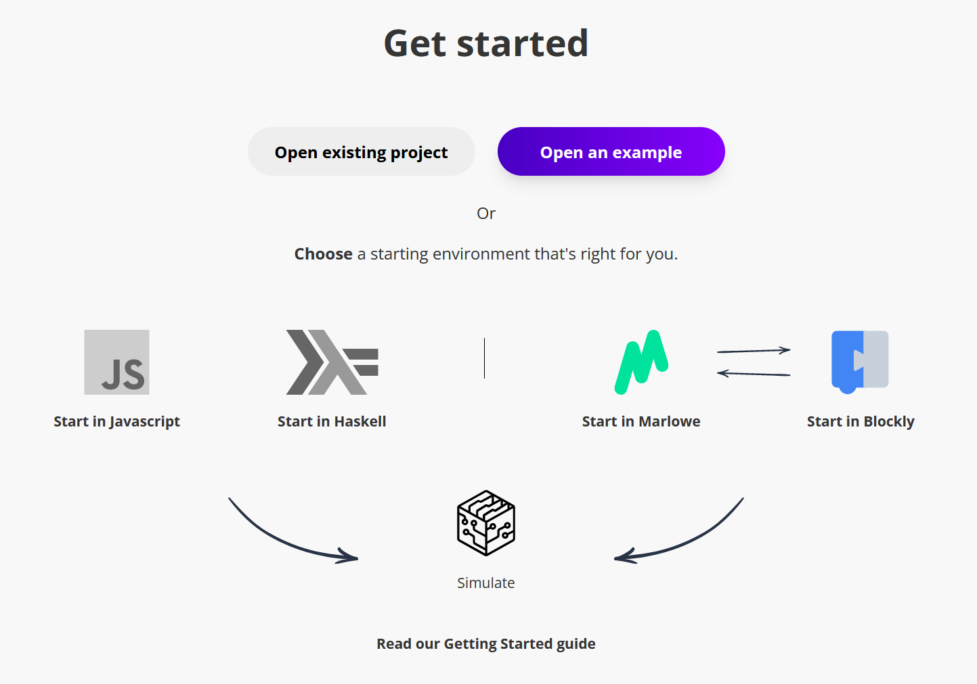


IOG Education
Video lectures with code:
Plutus Pioneer Program (github)
Marlowe Pioneer Program (youtube)
Atala Pioneer Program (webpage)
Playgrounds:
Plutus playground
Marlowe playground
Lectures from IOG:
IOG Academy channel
Input Output channel
Books:
Cardano for the masses ($)
Plutus – Learning a smart contract language
Mastering Cardano ($)

Slide 38


Cardano Projects
Climate Neutral Cardano:
alliance of Cardano stake pools
use 100% renewable energy for operating stake pool servers.
Supports environmental friendly
projects and initiatives

Slide 39

Companies using Haskell
Haskell in industry:
https://github.com/erkmos/haskell-companies
175 companies

Slide 40
What do programmers say that use Haskell?
My colleague: When learning Haskell it was as learning to walk again.
Programmers from successful companies: When programming in Haskell you program as if you were on autopilot. Runtime bugs that happen in production phase are much less common than in imperative languages.
Haskell creators: The answer to John Backus Turing award lecture question: “Can programming be liberated from the von Neumann style?”
Me personally: Haskell is the holly grail of programming languages.

Slide 41
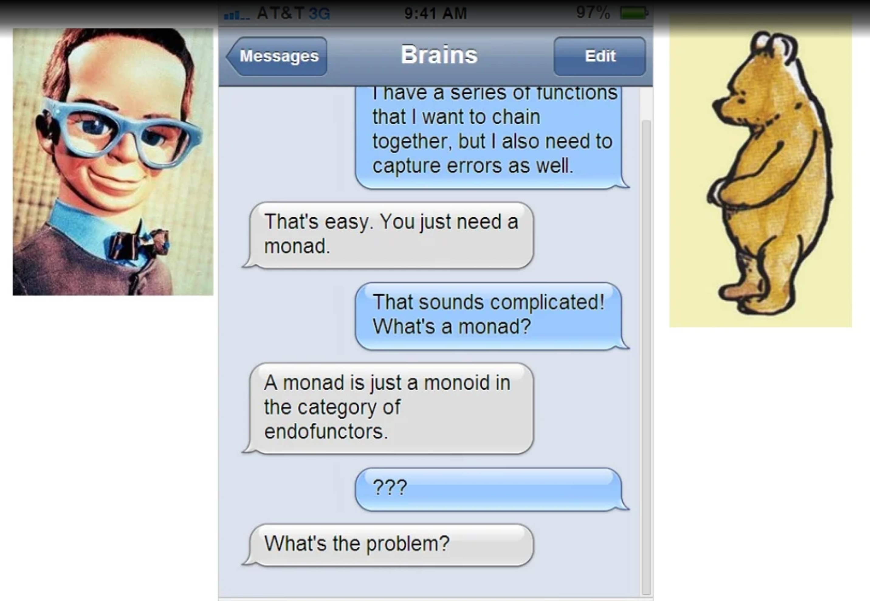
A casual Haskell conversation

Slide 42
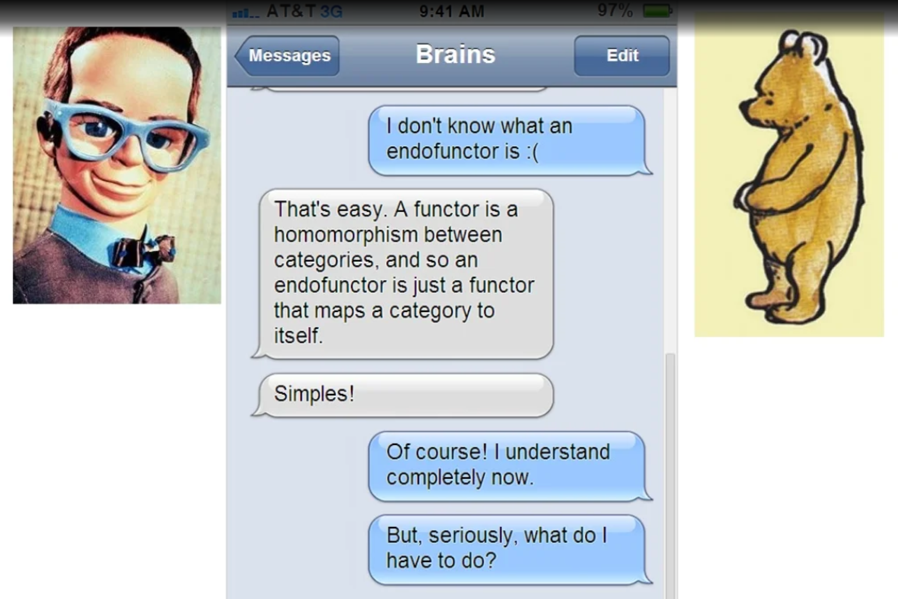

Slide 43
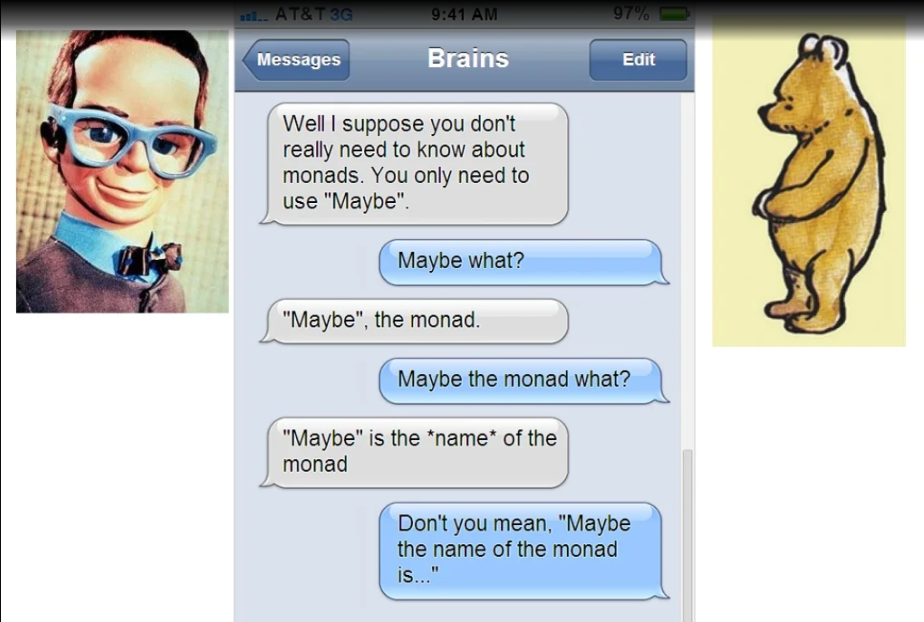

Slide 44
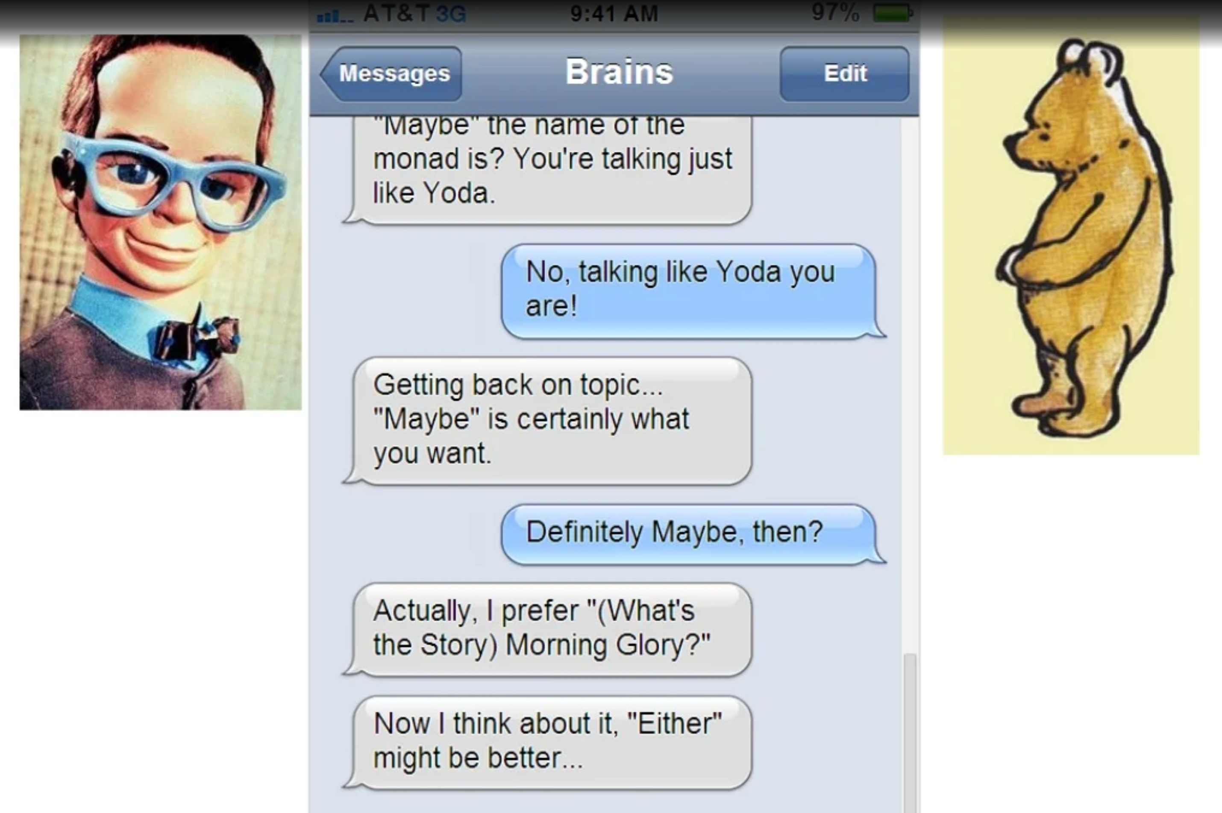
Oasis albums:
1st Definetly Maybe
2nd Morning Glory

Slide 45
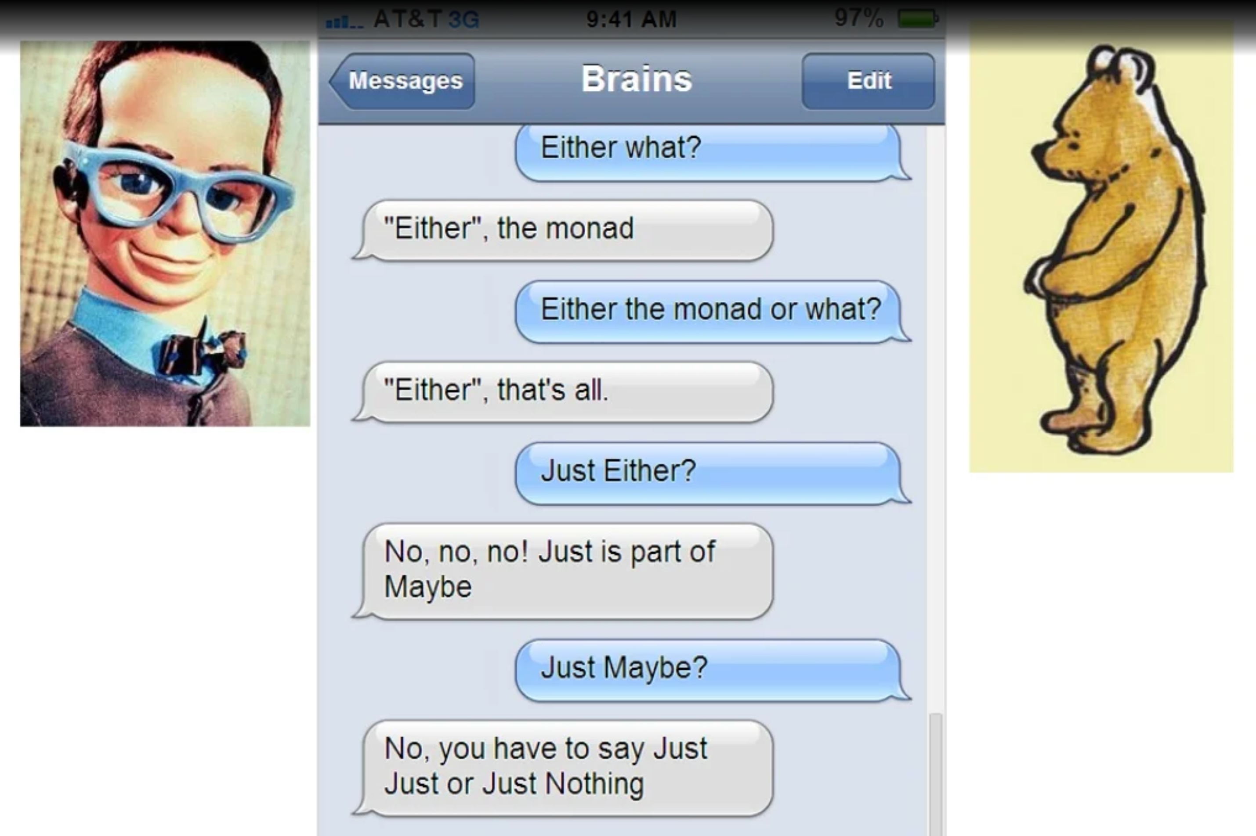

Slide 46
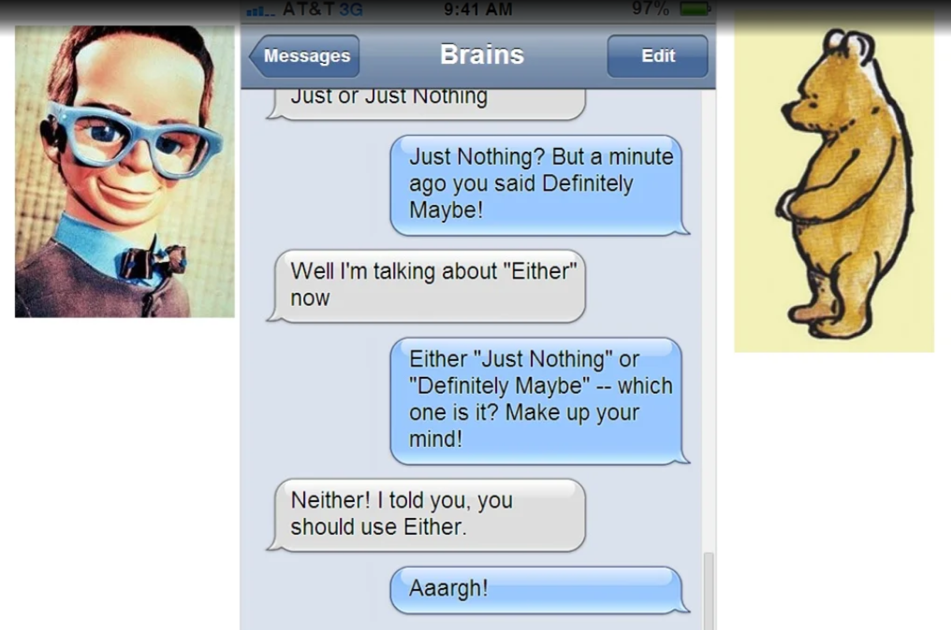

Slide 47
Thanks!
Luka Kurnjek IOG

